Slide 1


Slide 2

Remember that ALL cells contain the same genome, i.e., the same set of instructions
A fertilized egg gives rise to many different types of cells, each with a different function
What is behind this?
What is the role of gene expression in development?
What is the role of gene regulation in development?

Slide 3


Transformation of the zygote to multicellular organism results from three processes:
1. Cell division
2. Cell differentiation
3. Morphogenesis

Slide 4

CELL DIVISION: Mitosis of the fertilized egg (zygote) gives rise to a large number of genetically identical cells
DIFFERENTIATION: Process by which cells become specialized in structure and function
MORPHOGENESIS: Organization of different kinds of cells into specialized tissues and organs

Slide 5
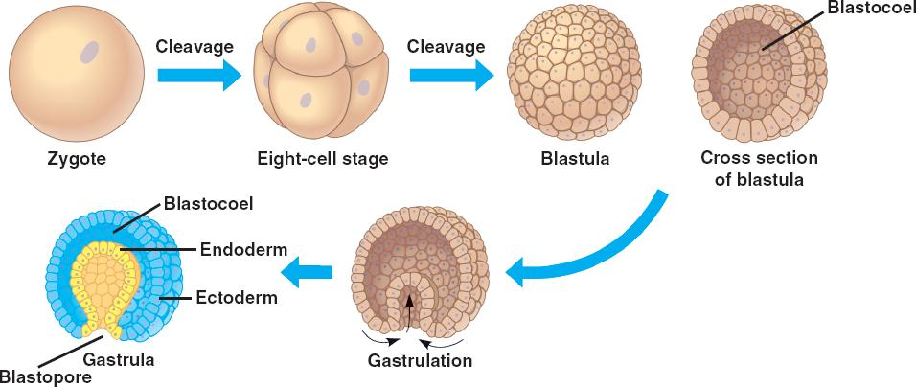

Slide 6
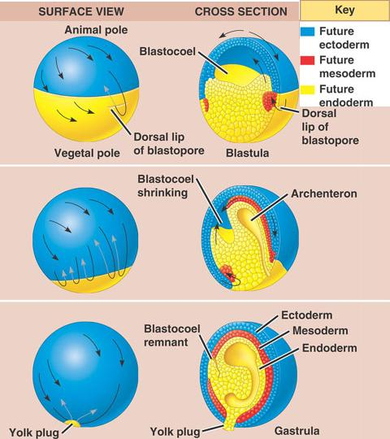

Slide 7
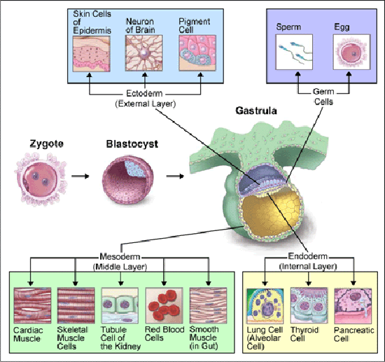

Slide 8
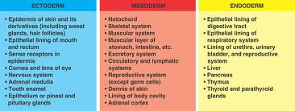

Slide 9

As we have seen, all cells of the body contain the same genome, the same set of genetic instruction
Differential gene expression results from genes being “turned on or off” in different types of cells
QUESTION: How do different sets of activators come to be present in different cells, such as a liver cell vs. a cell that makes up the lens of the eye?

Slide 10

Materials placed into the egg by the mother set up a sequential program of gene regulation
These substances are called CYTOPLASMIC DETERMINANTS
Egg’s cytoplasm contains both RNA and proteins encoded by mother’s DNA
However, mRNA, proteins, and organelles are not distributed evenly in the unfertilized egg
After fertilization and mitosis, cell nuclei of the embryo are exposed to different sets of these materials, resulting in expression of different genes

Slide 11
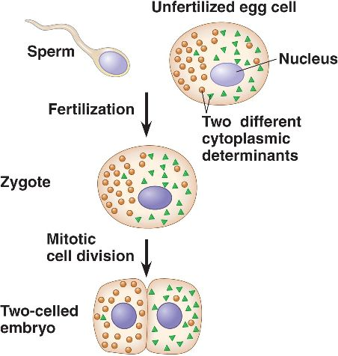

Slide 12

Environmental signals cause changes in target cells
And, as we’ve studied, signaling molecules start a cascade of complex molecular events
The cell is sent down a specific developmental path, causing changes in gene expression
These molecular changes lead to observable changes in cells

Slide 13
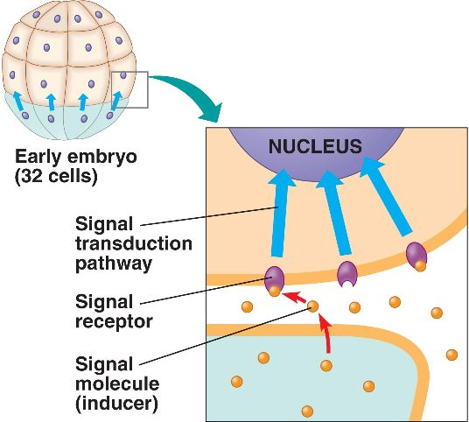

Slide 14
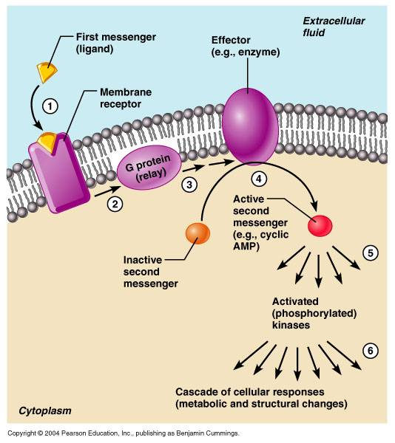

Slide 15

DETERMINATION describes the molecular processes in which an undifferentiated cell becomes committed to its ultimate fate
The outcome results from expression of tissue-specific proteins
Evidence of differentiation is marked by appearance of mRNAs for these proteins
Steps in gene expression are regulated primarily at level of transcription

Slide 16
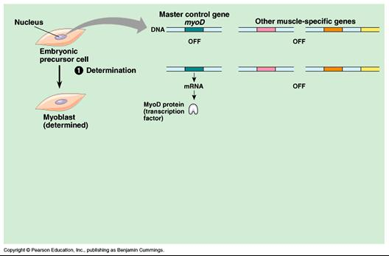

Slide 17

Cytoplasmic determinants and signals that we talked about a few minutes ago contribute to the development of the spatial organization of an organism’s tissues and organs
The process begins in the early embryo when the major axes of an animal are established

Slide 18
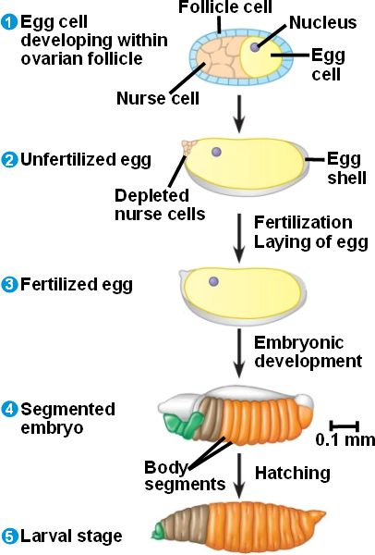

Slide 19
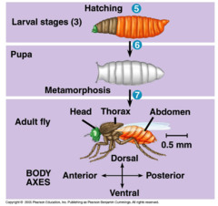

Slide 20

Homeotic genes control pattern formation, sort of like a master DNA switch
First investigated in Drosophila and C. elegans, a small nematode worm
In Drosophilia, scientists have found 1,200 genes essential for pattern formation during embryonic development
Errors in these genes result in abnormal patterns

Slide 21
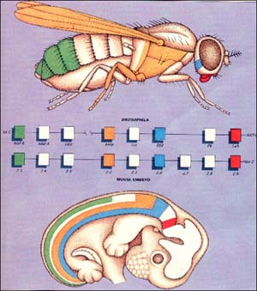

Slide 22

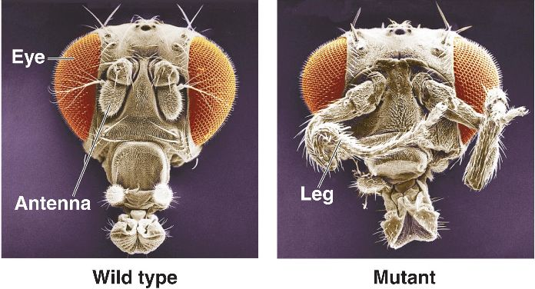

Slide 23

Cytoplasmic determinants from the egg initially determine the axes of the animal body
These substances result from the transcription and translation of MATERNAL EFFECT GENES
One group establishes the anterior-posterior axis, while another group set ups the dorsal-ventral axis

Slide 24
MORPHOGENS also help establish an embryo’s axes and other features of its form
An example of how this words can be demonstrated using the BICOID gene in Drosophila

Slide 25
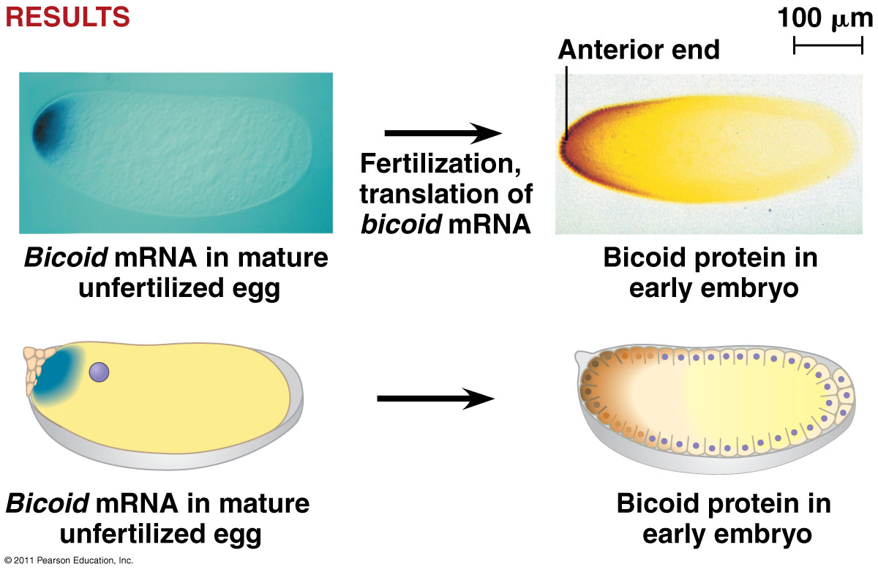

Slide 26
